Slide 1
Signal Acquisition and Data processing
NMR and MRI Application in Biotechnology

Slide 2
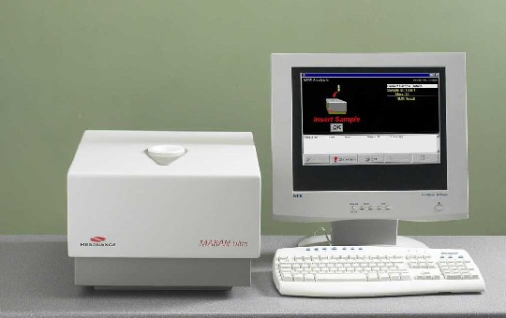
LF NMR
LR-NMR technology is nondestructive and non-invasive, rapid, and does not require environmentally unfriendly solvents, as opposed to standard analytical methods.
Because of all of these, it is widely used for routine analysis in agriculture, food, polymer, petroleum, chemical, pharmaceutical and medical industries.

Slide 3
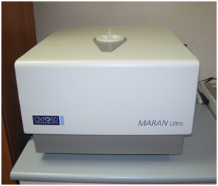
Signal Acquisition
Maran bench-top pulsed NMR analyzer (Resonance Instruments, Witney, United Kingdom) equipped with a permanent magnet and a 18 mm probe head operating at 23.4 MHz.

Slide 4
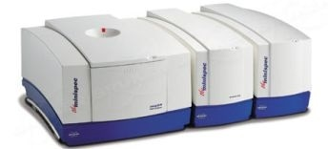
Signal Acquisition
20 MHz minispec bench-top pulsed NMR analyzer (Bruker Analytic GmbH, Germany), equipped with a permanent magnet and a 10-mm temperature controlled probe head.

Slide 5
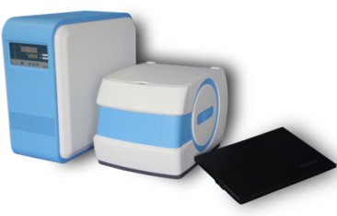
Signal Acquisition
MiniEDU20 NMR/MRI system (Niumag, China) equipped with a permanent magnet and a 10 mm probe head operating at 0.08 T.
Notes:
Basic parameters:
1.Magnet type: permanent magnet
2.Magnetic field intensity: 0.5±0.08T
3.Probe coil: Ø10mm
4.Weight: 49.8Kg

Slide 6
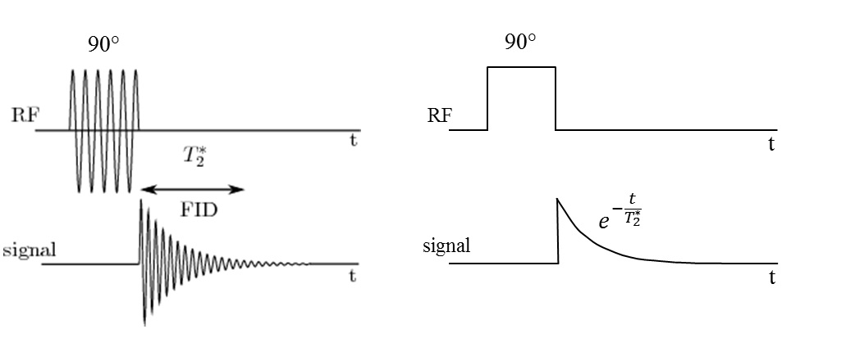
Signal Acquisition
Free Induction Decay (FID)
A single RF pulse (normally a 90 degree pulse) is applied to the sample and the response is measured as a function of time after the RF excitation
Set up the NMR instrument.

Slide 7
Signal Acquisition
CPMG Pulse Sequence
Named after the men who invented it (Carr, Purcell, Meiboom & Gill).
The CPMG sequence consists in applying a 90 degree RF pulse to the sample, followed by many 180 degree pulses.
Each time a 180 degree pulse is applied, the signal decay to the magnetic field is removed and a single data point is acquired.
The effects of the magnet on the signal are removed with this sequence
The decay constant of the exponential is called spin-spin or transverse relaxation time.
P90
τ
P180
2τ
P180
P180
P180
2τ

Slide 8
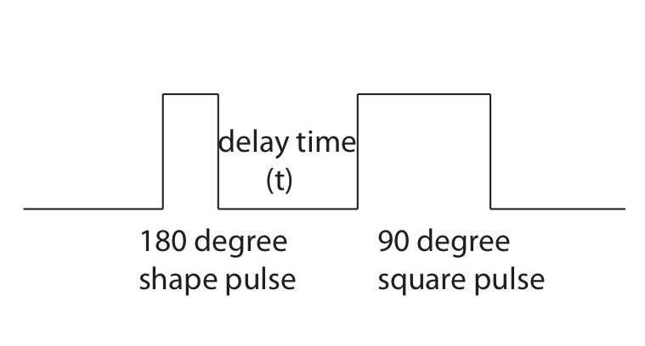
Signal Acquisition
Inversion Recovery sequence
Spin-lattice or longitudinal relaxation
Consists of a 180 degree pulse (inversion pulse) and a 90 degree pulse.

Slide 9
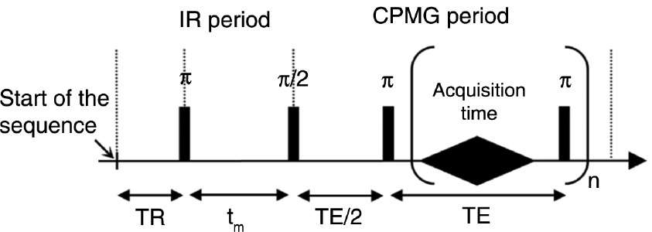
Signal Acquisition
Inversion Recovery- CPMG sequence
Contain T1 and T2 sequence.

Slide 10
Signal Processing
System/Model
K
Signal f(t)
Measurements s(t)
Noise ε(t)
By proper discretization
Can be basically solved as a Least Squares problem
This LS problem is highly ill-conditioned. Therefore, it is not possible to be solved without a regularization method to improve its condition and the numerical stability of the solution procedure.

Slide 11
Signal Processing
The most common regularization approaches apply the classical Tikhonov:
Tikhonov regularization approach gives a solution better posed and stable.
Nothing guarantees that the solution will be non-negative.
It tends to strongly over smooth the reconstructed spectrum function, which may result in merging close narrow peaks into a one wide peak and eliminate low volume peaks.
Another common practice for regularize the spectrum reconstruction problem is replacing the matrices K₁ and K₂ by their best low rank approximation using SDV compression.

Slide 12
Signal Processing
A general formulation of the reconstruction problem, with l1 regularization and non-negativity constraint is indicated below:
F ≥ 0
In order to solve the equation, it was adjusted and used the optimization algorithm Primal-Dual Convex Objectives (PDCO)

Slide 13
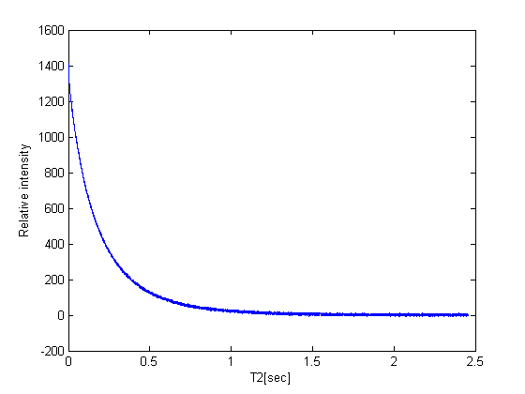
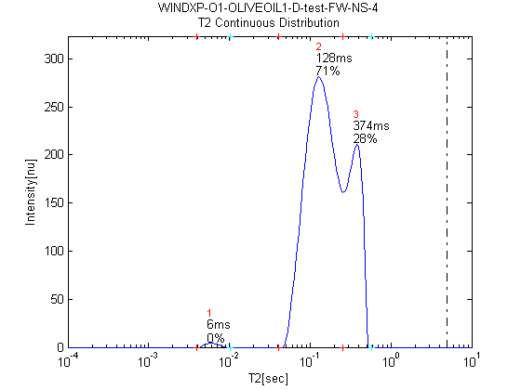
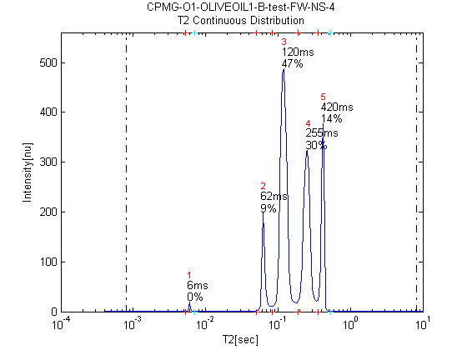
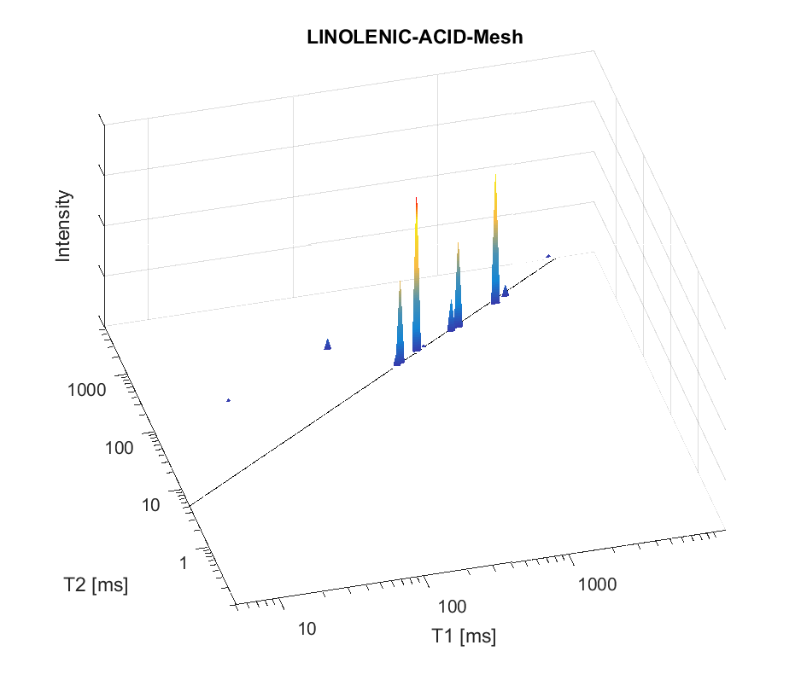
Sequence of Signal Analysis Developments with Ilt and PDCO
(1) MR Signal collection –Relaxation Curve S
(2a) Data Processing –
ILT – 1D Mapping
(2a”) Improved ILT PDCO L1/L2 – 1D Mapping
(3) Lipid Products Dictionary -
Time domain (TD) Peak Assignment
based on
Lipid Segmental Motion
(2b) Data Processing –
PDCO L1/L2 ITL –
2D T1-T2 Mapping
Increased peak generation and resolution
2
4
1
3
Key point: Choice of regulatory parameters L1 and L2
* PDCO – Primal Dual Convex Optimization, Saunders, 2001

Slide 14
Contact Information
Prof. Zeev Wiesman: wiesman@bgu.ac.il
Maysa Resende: mteixeiraresende@gmail.com
Dr. Janna Abramovich: janna@bgu.ac.il
Shosh Kravchick: kravch@bgu.ac.il
Plant Lipid Biotechnology Lab phone number: 074-7795272

